Slide 1

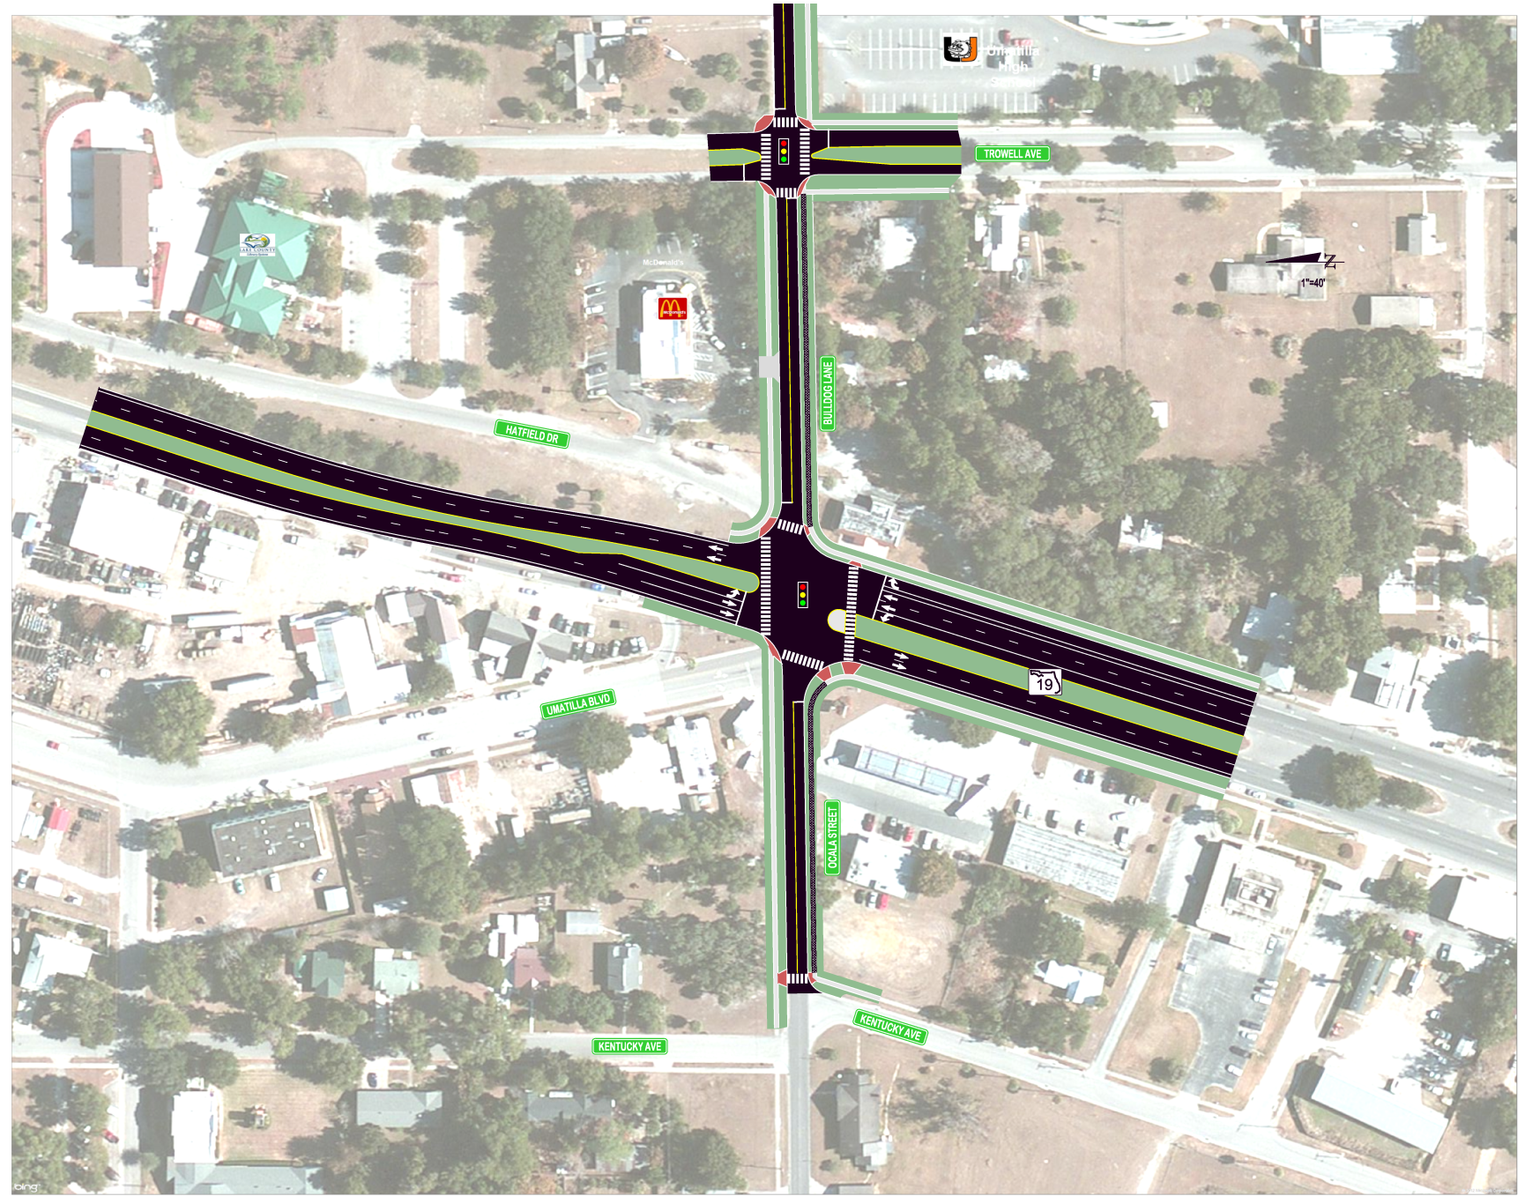


SR 19 Potential Improvement
Option: 4-Lane with Bicycle Lanes
For Planning Purposes Only
DRAFT
December 2012

Slide 2
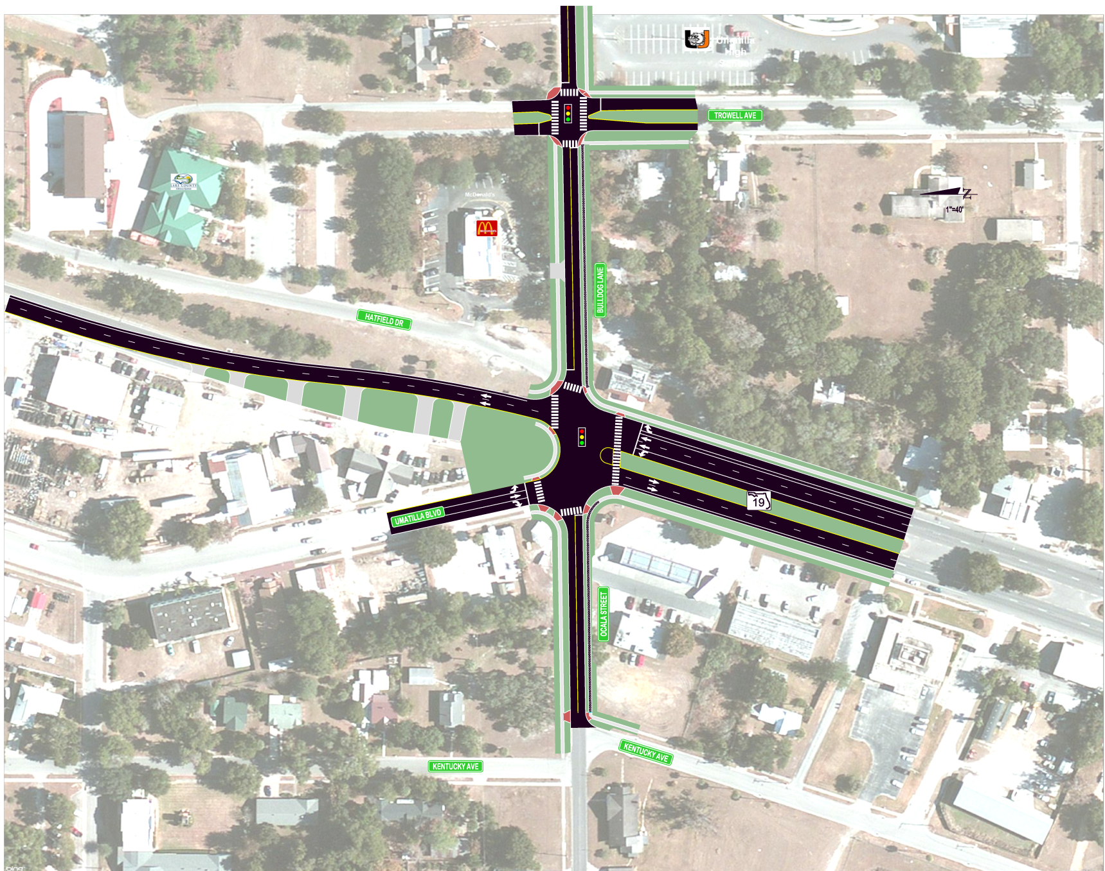
SR 19 Potential Improvement Option: One-Way Pair with Bicycle Lanes
For Planning Purposes Only
DRAFT
December 2012

